Slide 1

Presentation on Augmented Reality Car Customize App
Submitted by
Mayuri Sunil Patade
Shraddha Avinash Mane

Slide 2
Introduction
What is Augmented Reality?
Augmented Reality is a technology that enables virtual images to be overlaid on view of the real world.
In Augmented Reality can experience it any where or where he want.
It is abbreviated as AR.
Pokémon go is one of the example of augmented Reality.
Computer/Mobile Generated data
Augmented Reality
Physical, Real-world Environment (reality)

Slide 3
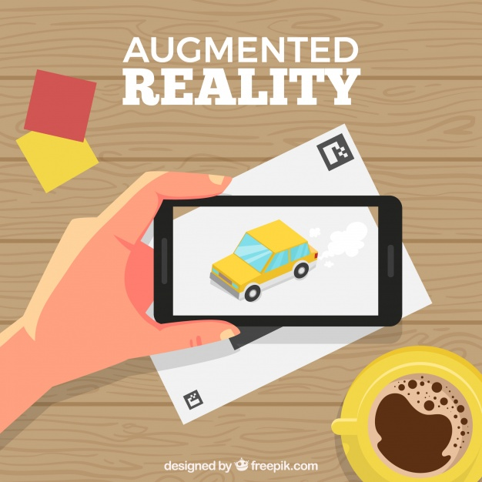
Statement About The Problem
Many of people doesn’t know about the car and the car features for that people can necessary to visit the showroom.
In Before buying a car Customer needs to go car showroom to decide car.
To travel to the showroom, he has to travel, he wastes time and takes time to get the car done.
Augmented reality is the solution for it.

Slide 4
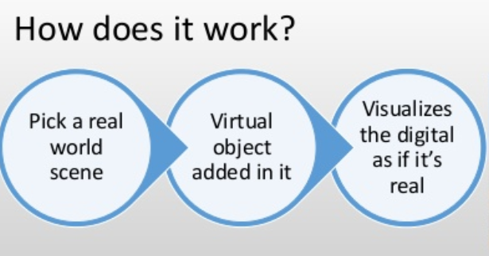
Why Is The Particular Topic Chosen ?
In augmented Reality customer can feel and experience it anywhere or where he want. It’s not necessary to have Real car with user we can experience in virtual car.
In this Augmented Reality Car Customizer App Demonstrated how a customer can have a look at a car model he is interested in & choose between various color options have peek at a interior.

Slide 5
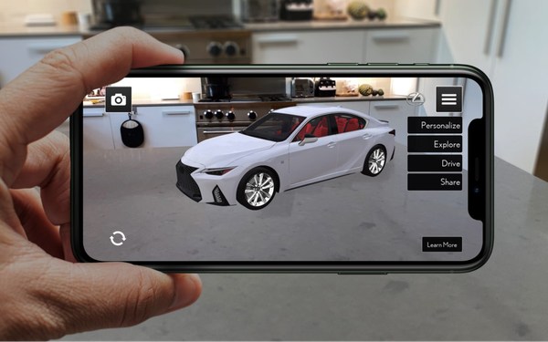
Objective Of The Project
Detect the Area for Placing the Car Model
Experience the Car Object
Car Rotate in and out
Car Interior Experience
Change the Colour
Information About The Model of Car

Slide 6
Scope Of The Project
In this augmented reality car app first scanning the area where he want to place the virtual car.
Then user can place the car model.
User can move around the car feel the real car experience.
User can check the features of the model .
The user can customized the car there is a options to change the colors.
User can open door and the check the interior features of the model ,
User can check information about model of the car and change the scale car.

Slide 7




Hardware And Software To Be Used
Hardware –
RAM 8 GB
Windows 8 & above
Android Mobile AR Core (Supported Version 8 and Above).
Software –
Unity Engine 2.1.3
ARCore Plugin
Visual Studio 2019
Android studio

Slide 8
Augmented Reality For Project
In this Augmented Reality Car Customizer App Demonstrated how a customer can have a look at a car model he is interested in & choose between various color options have a peek at the interior.
Detect the Area for Placing the Car Model:- Scans the ground first and then places the car object when the area is scanned.
Experience the Car Model:- Can move object around the car and view it.
Car Rotate in Rotate Out:-Can rotate in or rotate out of car object.
Car Interior Experience:-By going inside the car object we can experience the interior
Change the Color:- Can change the color of a car object.
Information About The Model of Car:- Can see information of parts of car objects one by one.

Slide 9

Car Customized App Using AR

Slide 10
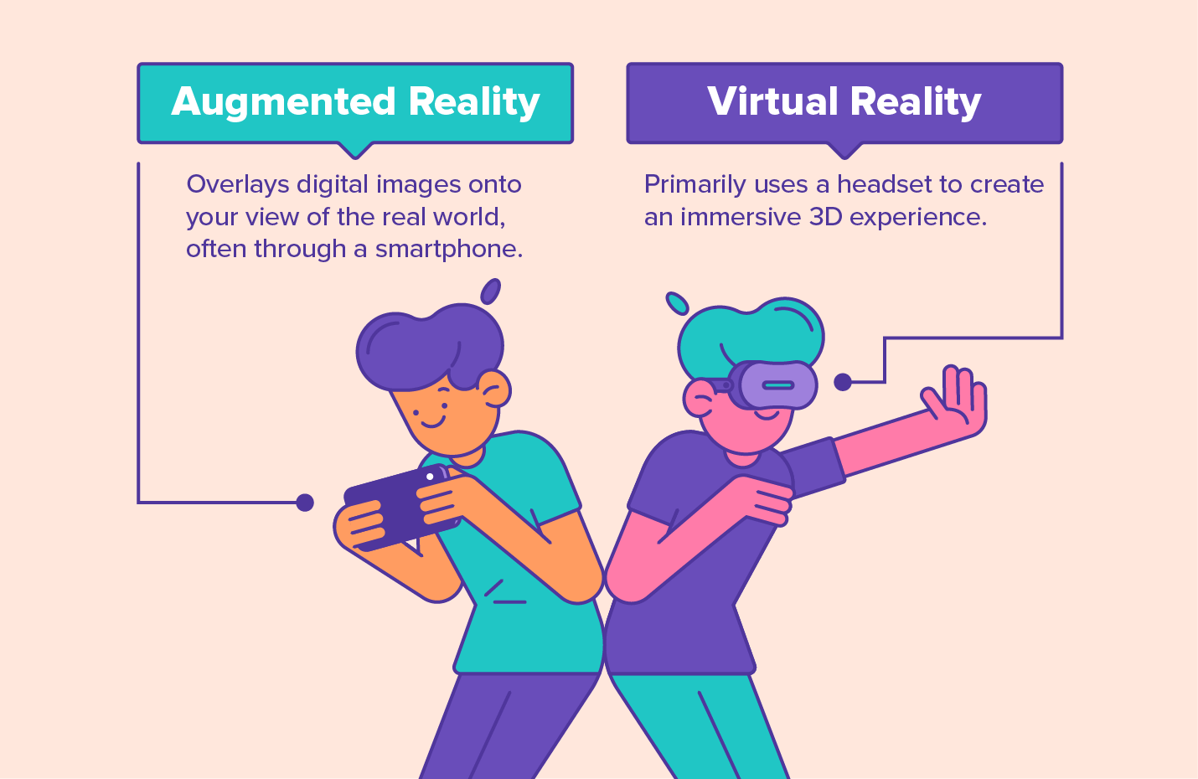

Slide 11
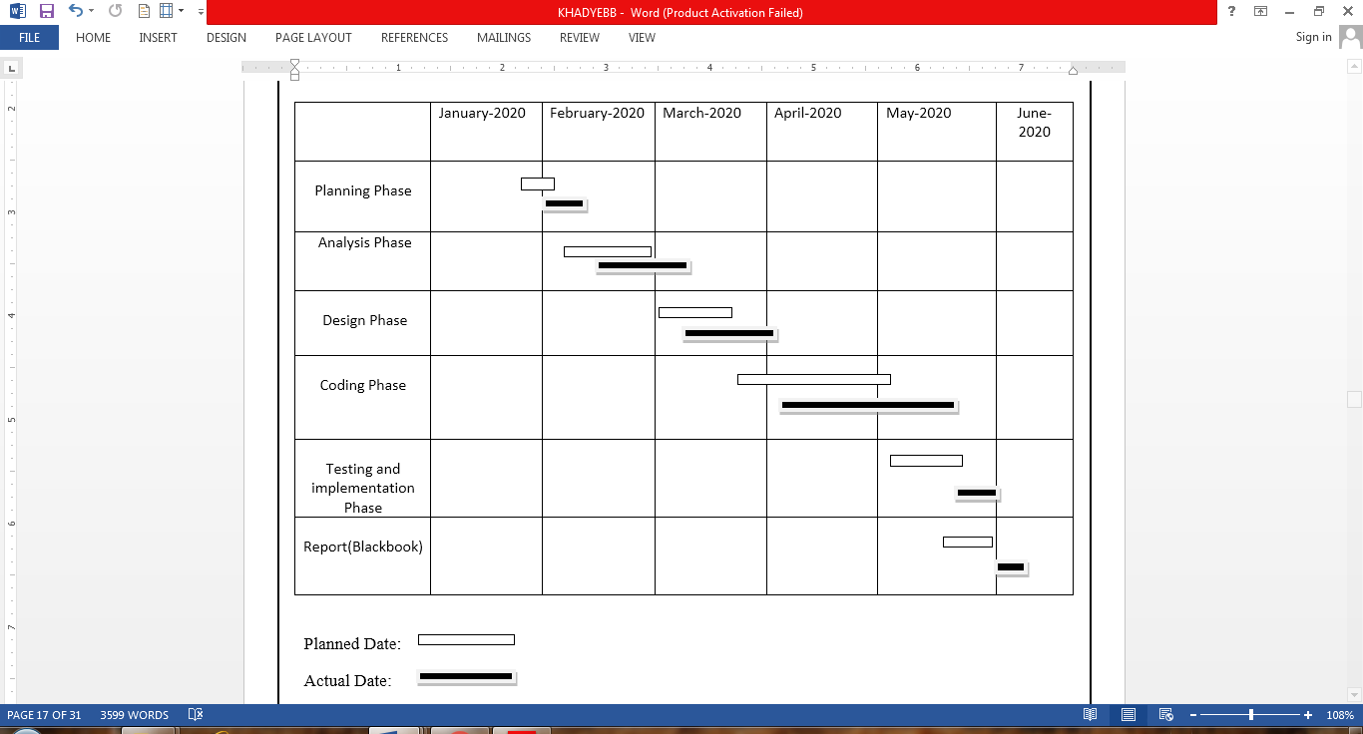
System Planning
Gantt Chart
Gantt Chart is horizontal bar chart that visually represents a project plan over time.

Slide 12
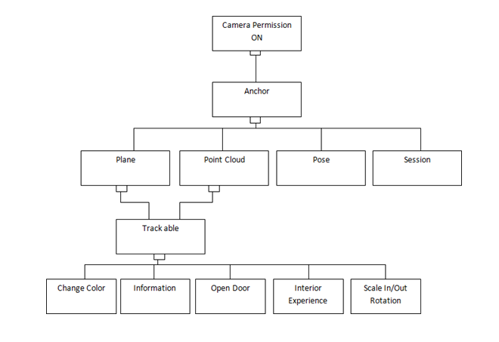
Detailed Life Cycle Of The Project
Work Breakdown Structure
Work Breakdown Structure is a hierarchical tree structure that outlines the project and breaks down into smaller, more manageable portions.
Simply dividing complex project to simpler and manageable task.

Slide 13
Process Model
Iterative model
Iterative Model is a part of Software Development Life Cycle.
It is a particular implementation of a software development life cycle that focuses on an initial, simplified implementation, which then progressively gains more complexity and a broader feature set until the final system is complete.
In short, iterative development is a way of breaking down the software development of a large application into smaller pieces.

Slide 14
What is Iterative Model in Software Development Life Cycle (SDLC)?:
An iterative life cycle model does not start with a full specification of requirements. In this model, the development begins by specifying and implementing just part of the software, which is then reviewed in order to identify further requirements.
Moreover, in iterative model, the iterative process starts with a simple implementation of a small set of the software requirements, which iteratively enhances the evolving versions until the complete system is implemented and ready to be deployed.
Each release of Iterative Model is developed in a specific and fixed time period, which is called iteration.

Slide 15
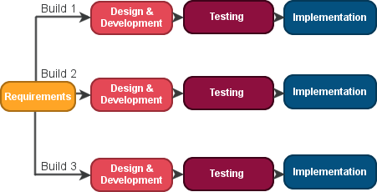
Process Of Iterative Model:
I am using Iterative Model in my project because the process of Iterative Model is cyclic, unlike the more traditional models that focus on a rigorous step-by-step process of development.
In this process, once the initial planning is complete, a handful of phases are repeated again and again, with the completion of each cycle incrementally improving and iterating on the software.

Slide 16
UML Diagrams
UML, which stands for Unified Modeling Language, is a way to visually represent the architecture, design, and implementation of complex software systems. UML diagrams divide that software system into components and subcomponents.
Here are the uml diagrams of the project :
Flow chart
Data flow diagram
Use case diagram
Sequence diagram
Activity diagram

Slide 17
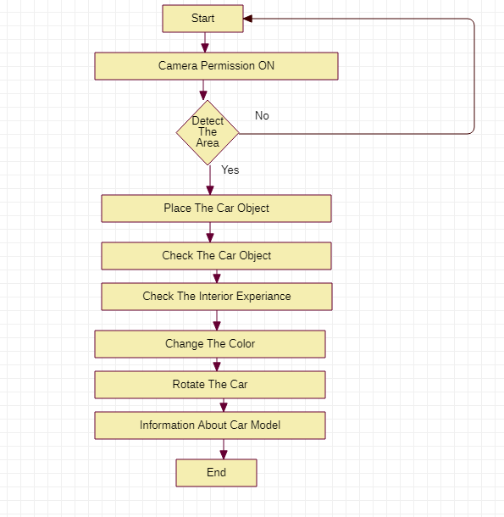
Flow Chart
Flowchart is a diagrammatic representation of sequence of logical steps of a project.
It is used in designing the process. Flow Chart VS Data Flow diagram Flow Chart present steps to complete a process while , DFD represent flow of data.

Slide 18
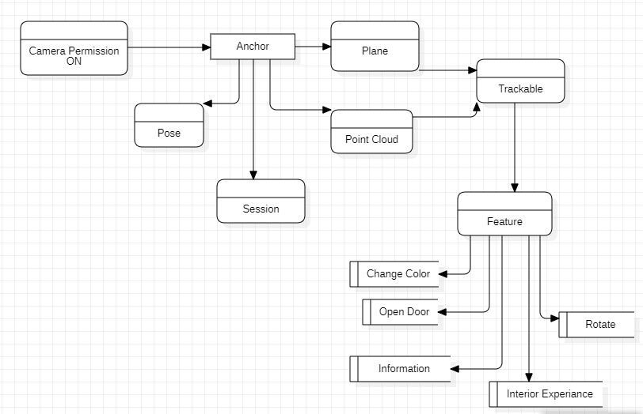
Data Flow Diagram
A data-flow diagram is a way of representing a flow of data through a process or a system.
The DFD also provides information about the outputs and inputs of each entity and the process itself.

Slide 19
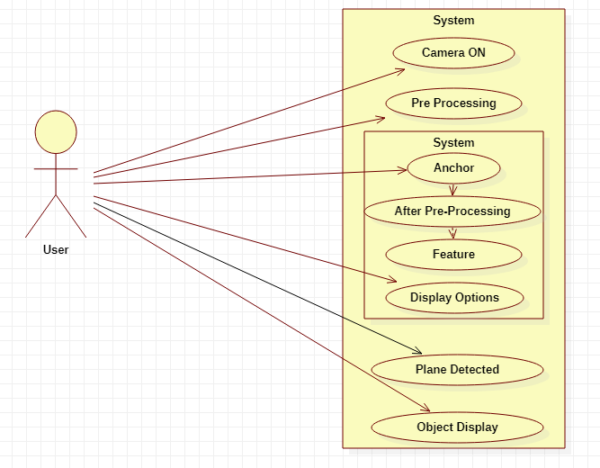
Use Case Diagram
A use case diagram at its simplest is a representation of a user's interaction with the system that shows the relationship between the user and the different use cases in which the user is involved.

Slide 20
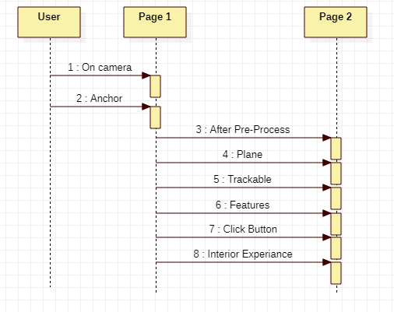
Sequence Diagram
Sequence diagrams show object interactions arranged in a time sequence
A sequence diagram is a type of interaction diagram because it describes how—and in what order—a group of objects works together.

Slide 21
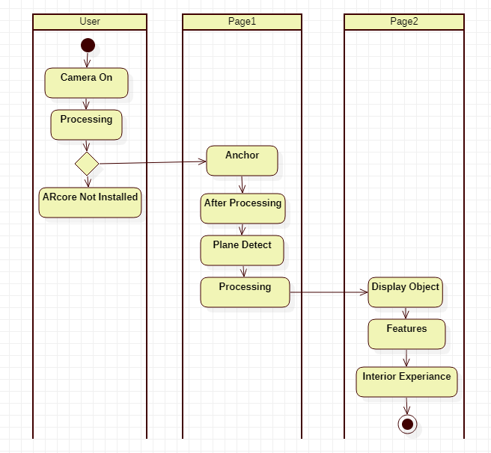
Activity Diagram
Activity diagram is represent the flow from one activity to another activity.
The control flow is drawn from one operation to another. This flow can be sequential, branched, or concurrent.
It captures the dynamic behavior of the system.

Slide 22
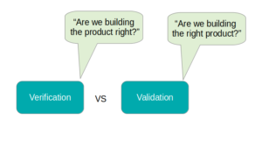
Methodology Of Testing
Software Testing is evaluation of the software against requirements gathered from users and system specifications.
Software testing comprises of Validation and Verification.
Validation is process of examining whether or not the software satisfies the user requirements.
Verification is the process of confirming if the software is meeting the business requirements,

Slide 23
Manual Testing
Manual testing
Manual Testing is a process of finding out the defects or bugs in a software program. In this method the tester plays an important role of end user and verifies that all the features of the application are working correctly.
The tester manually executes test cases without using any automation tools. The tester prepares a test plan document which describes the detailed and systematic approach to testing of software applications.
Test cases are planned to cover almost 100% of the software application.
As manual testing involves complete test cases it is a time consuming test.

Slide 24
Test Cases
Sr. no | Test case name | Test case Description | Input | Expected Output
1. | Camera Permission on | Camera on for scan the plane | Allowing camera permissi on | Camera on
2. | Scanning plane | Scanning plane for place the object on ground | Searchin g plane area | Pop out the scanning area
3. | Place object on plane | Place the object where user want to place it. | Tap on screen to place the object | Place the objet on plane area
4. | Changing color | Changing color of object to custumised | Tap on button to change color | Object change the color
5. | Display information about car | To see the information about the car | Tap on button to see informati On | Display the information.

Slide 25
Test Report
Sr . no | Test case name | Test case Description | Input | Expected Output | Actual Output | Remark
1 | Camera Permission on | Camera on for scan the plane | Allowing camera permission | Camera on | Not get permission option | Failed
2 | Camera Permission on | Camera on for scan the plane | Allowing camera permission | Camera on | get permission option and camera on. | Passed
3 | Scaning plane | Scanning plane for place the object on ground | Searching plane area | Popout the scanning area | Not detected plane | Failed
4 | Scaning plane | Scanning plane for place the object on ground | Searching plane area | Popout the scanning area | Plane detected | Passed
5 | Place object on plane | Place the object where user want to place it. | Tap on screen to place the object | Place the objet on plane area | Object not place properly | Failed

Slide 26
Test Report
Sr . no | Test case name | Test case Description | Input | Expected Output | Actual Output | Remark
6 | Place object on plane | Place the object where user want to place it. | Tap on screen to place the object. | Place the object on plane area | Object place properly | Passed
7 | Changing color | Changing color of object to customized | Tap on button to change color | Object change the color | Object change the color | Passed
8 | Display information about car | To see the information about the car | Tap on button to see informatio n | Display the information. | Display information | Passed
9 | Check animation of door | User can interact with object. | Tap on button to open the doors. | Opening the door | Door is open | Passed
10 | Scale in Scale out | To scale the object | Pinch to scale in scale out | Object get scale in scale out. | Not scaling. | Failed

Slide 27
Test Report
Sr .no | Test case name | Test case Description | Input | Expected Output | Actual Output | Remark
11 | Scale in Scale out | To scale the object | Pinch to scale in scale out | Object get scale in scale out. | Scaled object | Passed
12 | Rotation | To rotate the object. | Swipe to rotate. | Object get rotate. | Not rotate | Failed
13 | Rotation | To rotate the object. | Swipe to rotate. | Object get rotate. | Rotated | Passed
14 | Interior experience | To get the interior experience | Inside to object To see | Interior experience get | Interior experience get | Passed

Slide 28
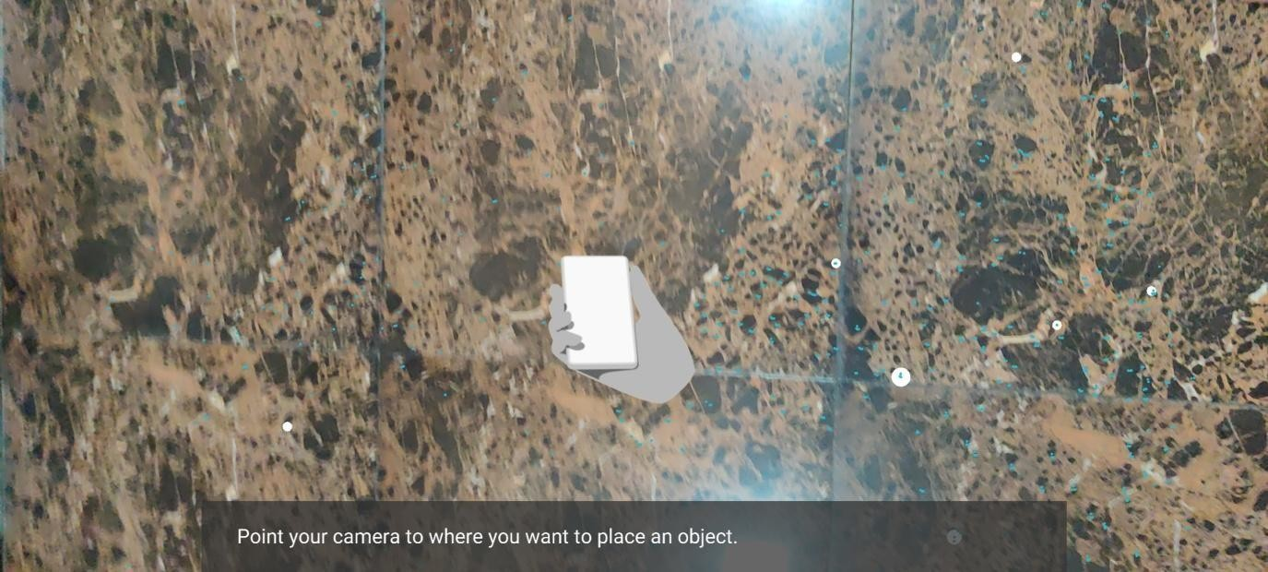
Input And Output Screen Designs
Ground Scanning:-

Slide 29
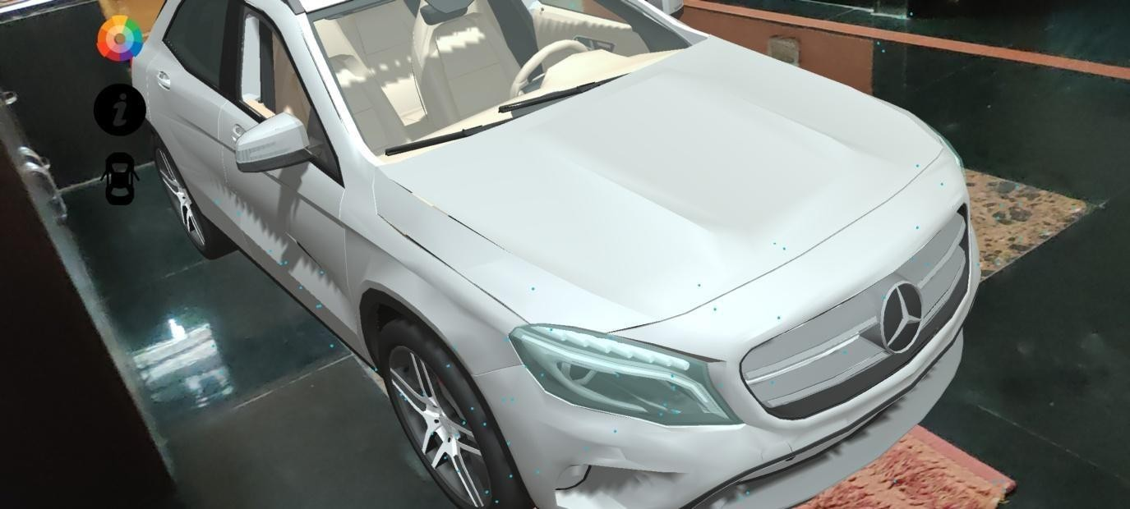
Input And Output Screen Designs
Place Car Object:-

Slide 30
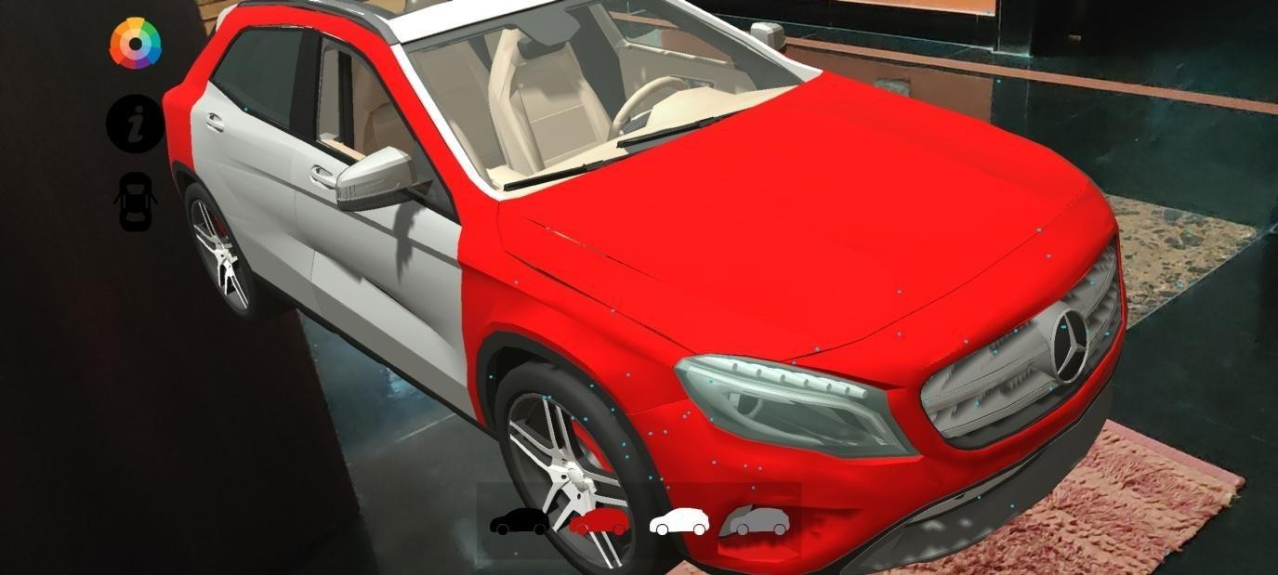
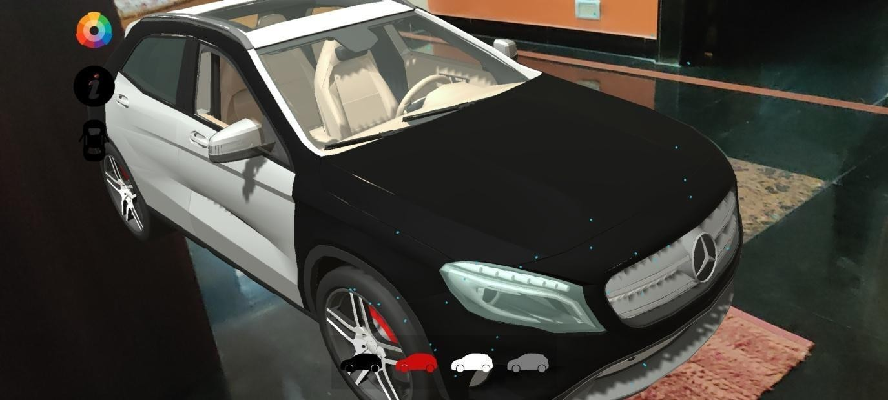
Input And Output Screen Designs
Change Color:-

Slide 31
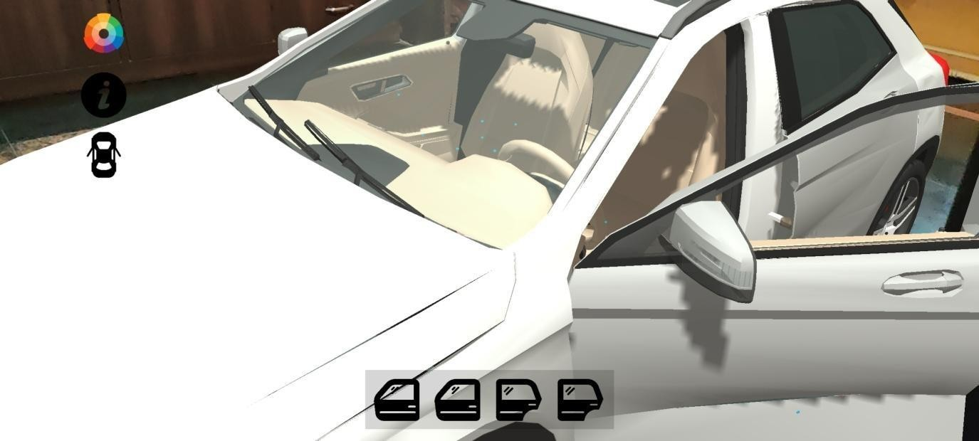
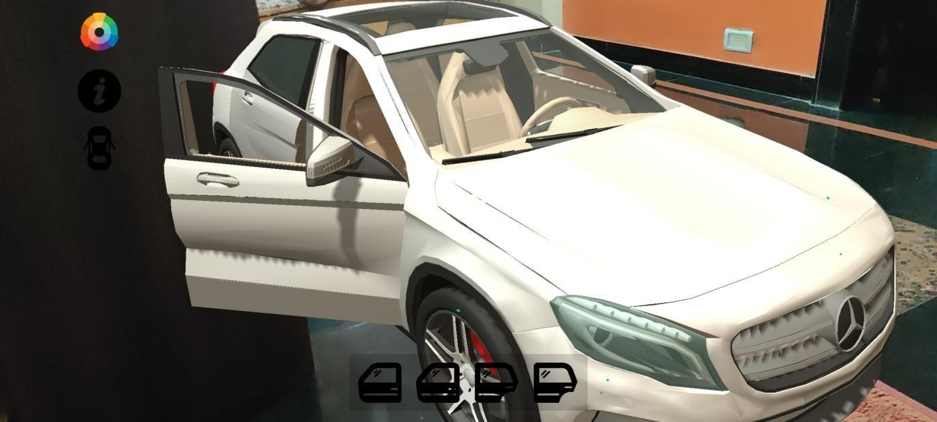
Input And Output Screen Designs
Interact With Car object:-

Slide 32
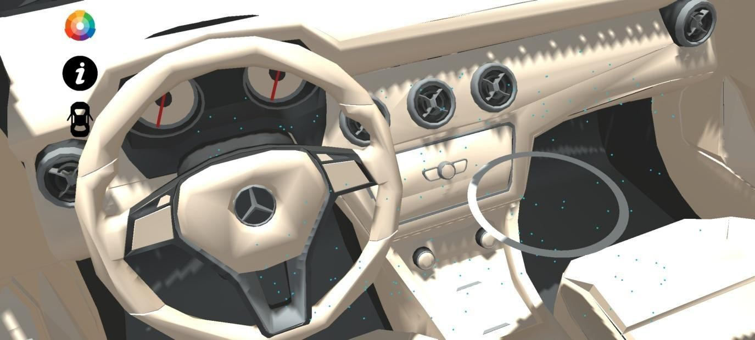
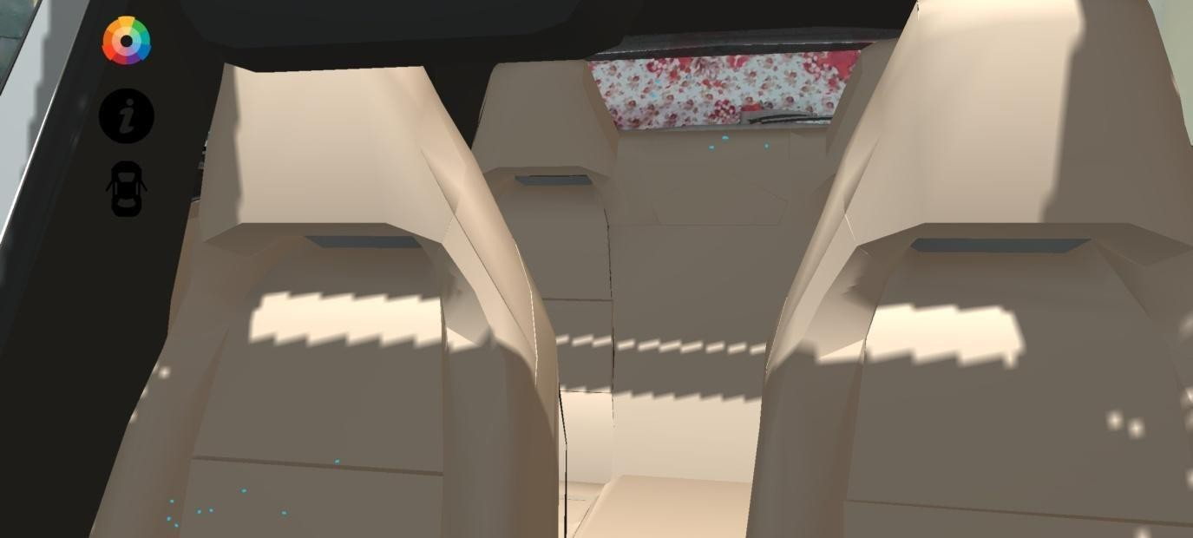
Input And Output Screen Designs
Interior Experience:-

Slide 33
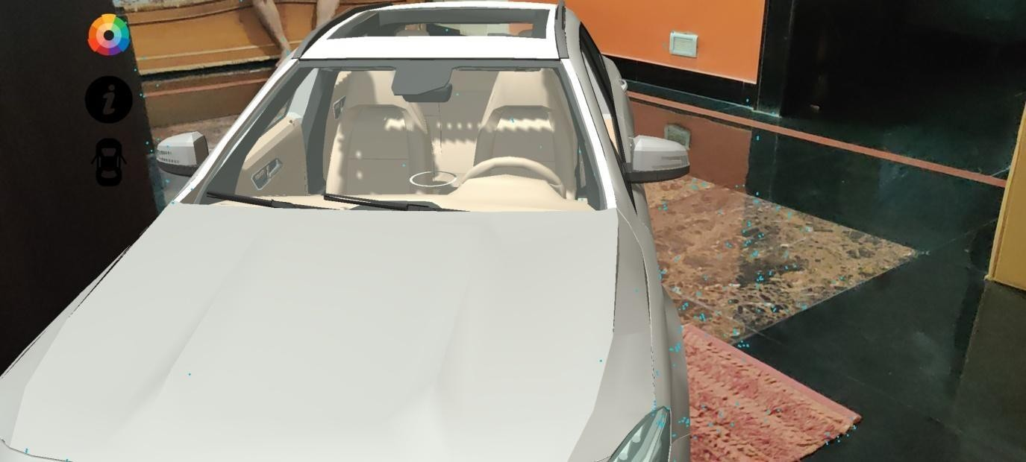
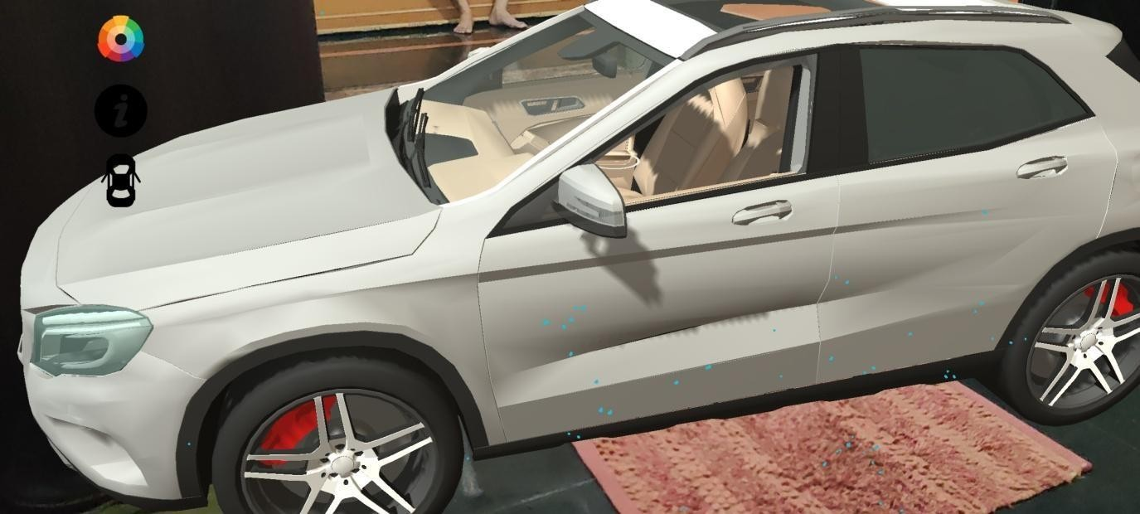
Input And Output Screen Designs
Car Rotate And Scale In Scale Out:-

Slide 34
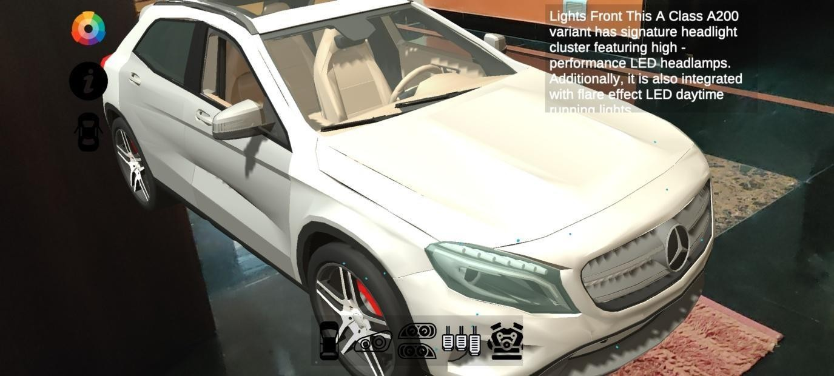
Input And Output Screen Designs
Car Part Information:-

Slide 35
Conclusion
In augmented Reality customer can feel and experience it anywhere or where he want. It's not necessary to have Real car with user we can experience in virtual car.
The interaction with augmented world is in two ways, using physical objects placeholder objects and by hand gestures.
Created an Augmented Reality app to show how automobile companies can integrate AR in their app so that interested buyers can have a quick look on how various car models look in different colors.
so buyer can quickly decide on which features he want in his new car and confirm his decision by going to the showroom just to take a test-drive this would save a lot of time

Slide 36
Future Enhancement
Improve interaction in augmented reality (for the field personnel)
Increase immersion and situational awareness for spatially distributed users in the virtual reality and augmented reality. Future work will focus on preparing a fully functional car simulation. We can add the feature of drive the car. We can create same feature in website so no need to download the app and add Buy Option so user can buy a car online

Slide 37
Reference And Bibliography
Reference
Title- Augmented Reality based Platform to share virtual worlds
Author-Prof. Dhananjay Gaikwad1, Akash Chikane2, Shrikrishna Kulkarni3, Aishwarya Nhavkar4
Date of Paper- Jan-2018
Bibliography
https://unity.com/
https://developers.google.com/ar
https://sketchfab.com/3d-models/

Slide 38
Thank you

